Slide 1
Predict Future Sales
Data Analytics using R
Presented By:
Sakshee Parnerkar (sp2772)

Slide 2
Description
Sales prediction - The process of estimating future sales by predicting the amount of product or services an individual salesperson, a sales team, or a shop is likely to sell in a fixed time period i.e. weekly, monthly, quarterly, or yearly.
Sales prediction is the best example of predictive analytics.
Sales predictions provide key data so that the team can make decisions to improve the sales by tweaking contributing factors.

Slide 3
Problem Statement
To forecast the total amount of product sold in every shop for the test set. Here, the list of shops and products slightly changes every month. Our main aim is to create a robust model that can handle such situations.
Make a Machine learning model which could learn by training the model and then test the data.
Creating new variables by using groupby and merging columns which could give us the best analysis and thus better understanding.

Slide 4
Dataset Information
Glimpse of Data:
Sales_train.csv: Rows- 2,935849; columns - 6
items.csv: Rows- 22,170; columns - 3
test.csv: Rows- 214,200; columns - 3
item_categories.csv: Rows-85; columns - 2

Slide 5
Libraries Required
dplyr: Data Manipulation
ggplot2: Plotting
lubridate: Data Wrangling
caret: streamline the model building and evaluation process
e1071: Building Model
tictoc: Timing Function
gbm: Generalized Boosted Regression Models

Slide 6
Approach- Merge, EDA, Model Building
Data Preparation - got the item category details in the sales data
EDA
Model Building - Used tictoc function and Gbm function to create the model.
Tic function- starts timer of the execution and stores the time on stack.

Slide 7
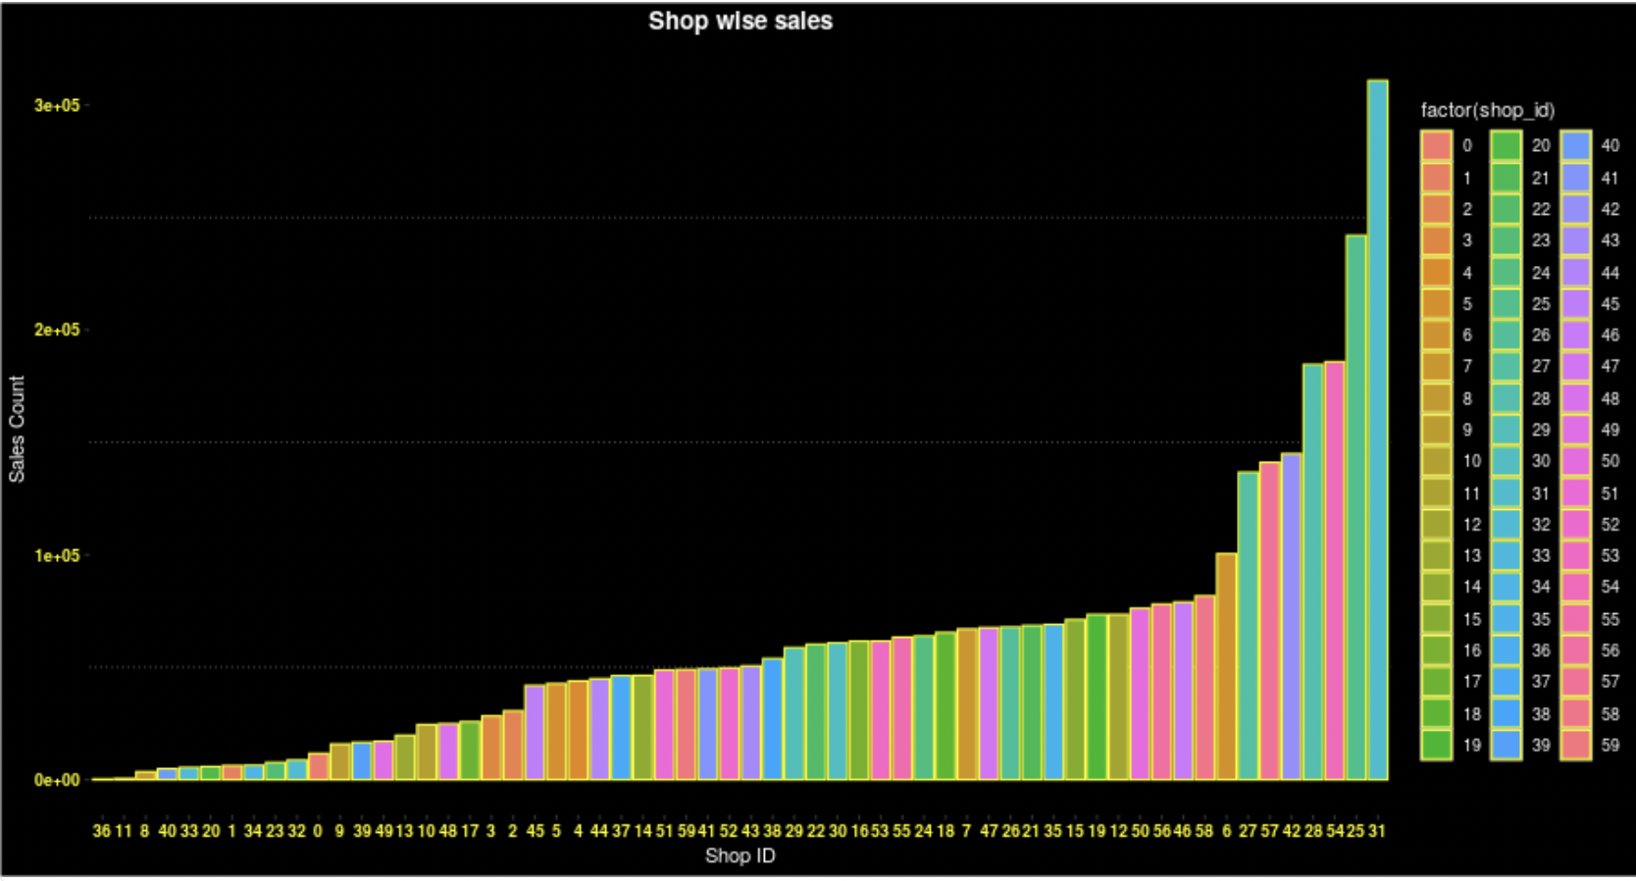
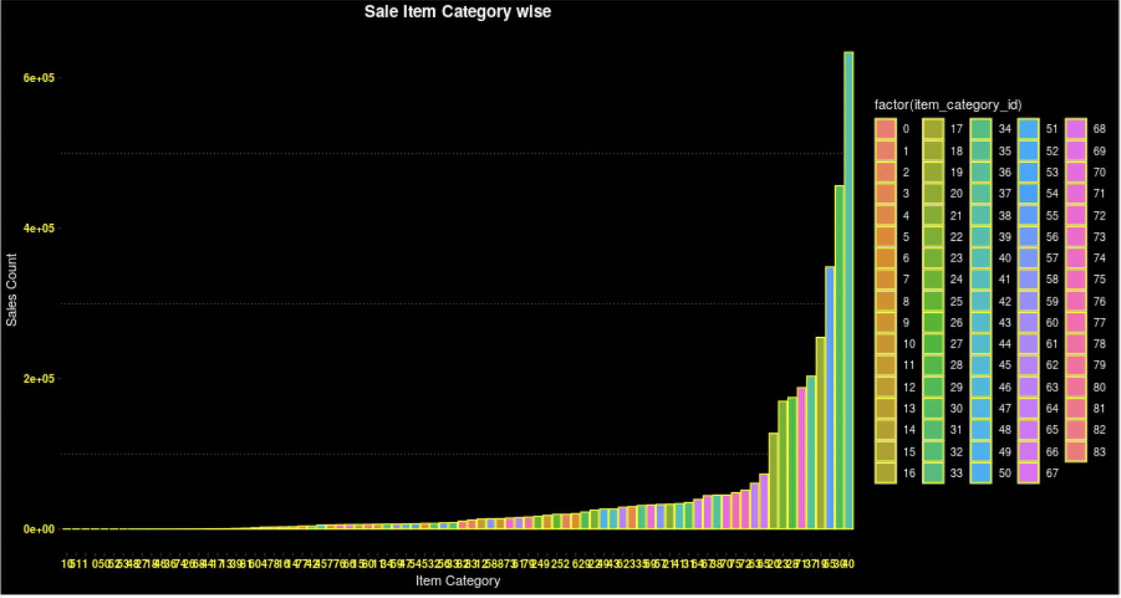
Shop wise sales and sale item category wise

Slide 8
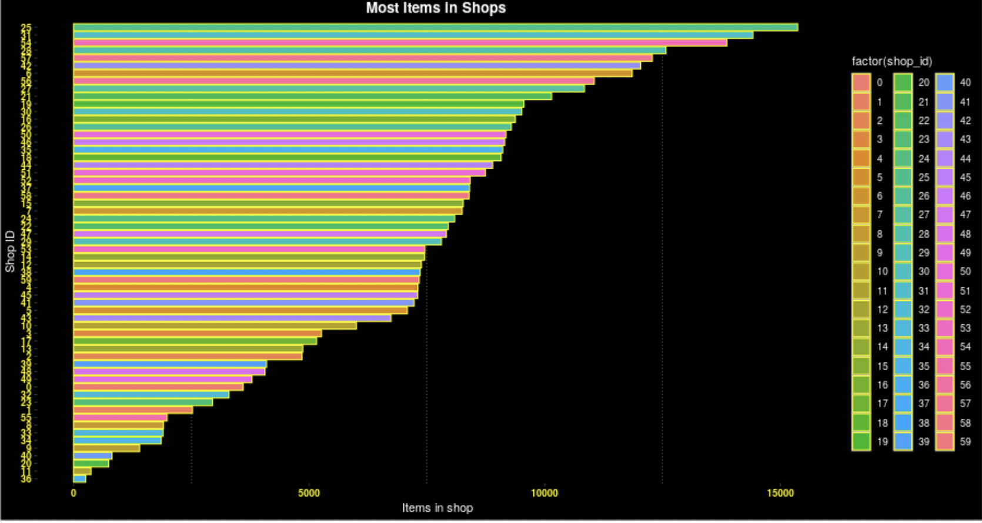
Most Items in Shops per Shop ID

Slide 9
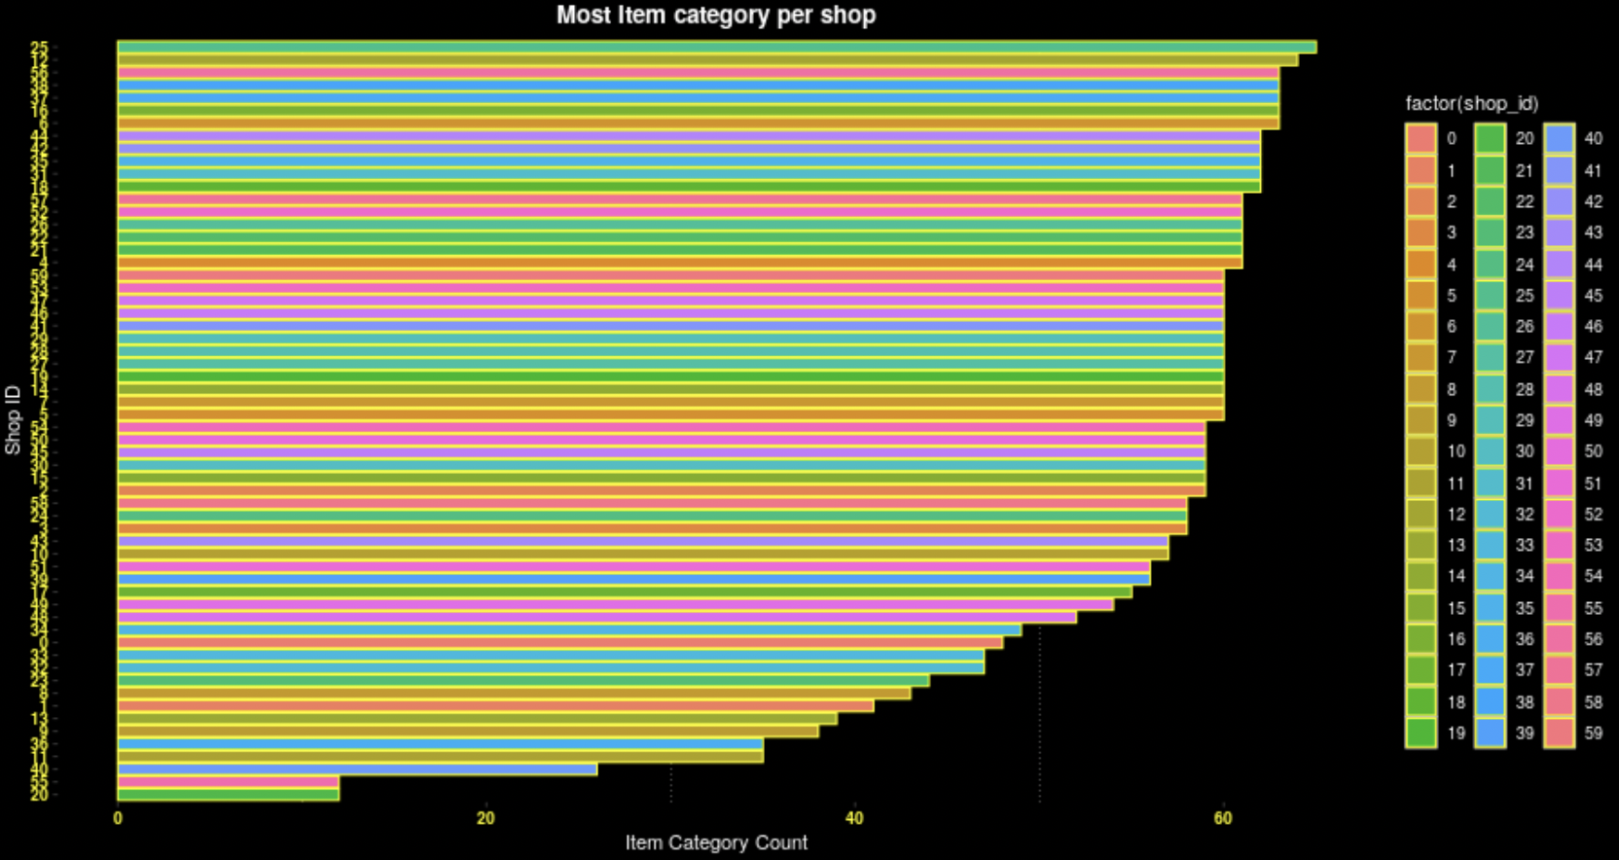
Most Item Category per Shop

Slide 10
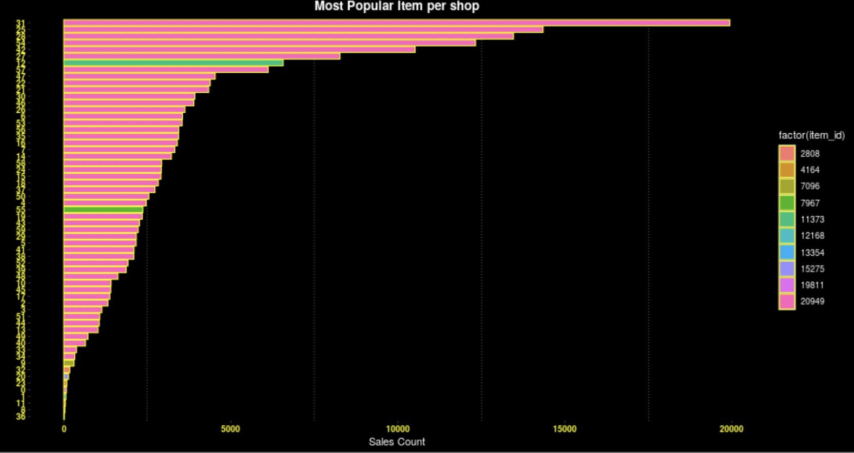
Most Popular item per shop

Slide 11
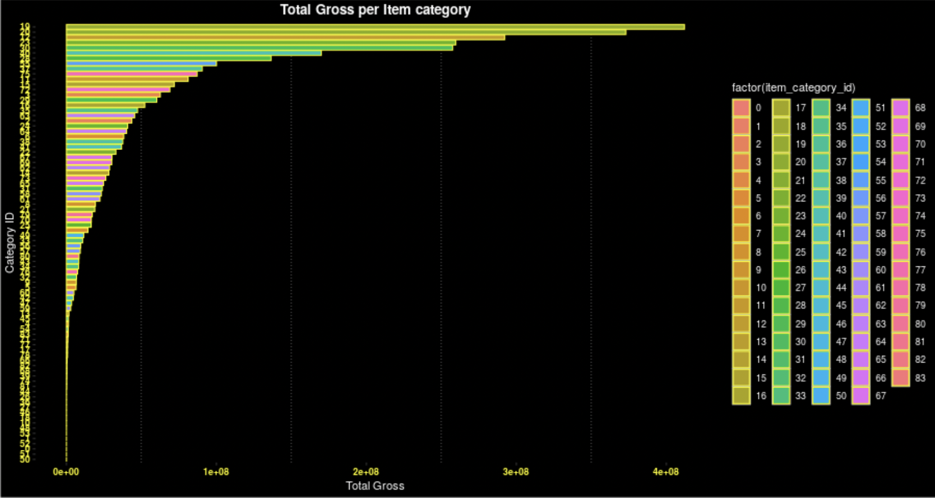
Total gross per Item category

Slide 12
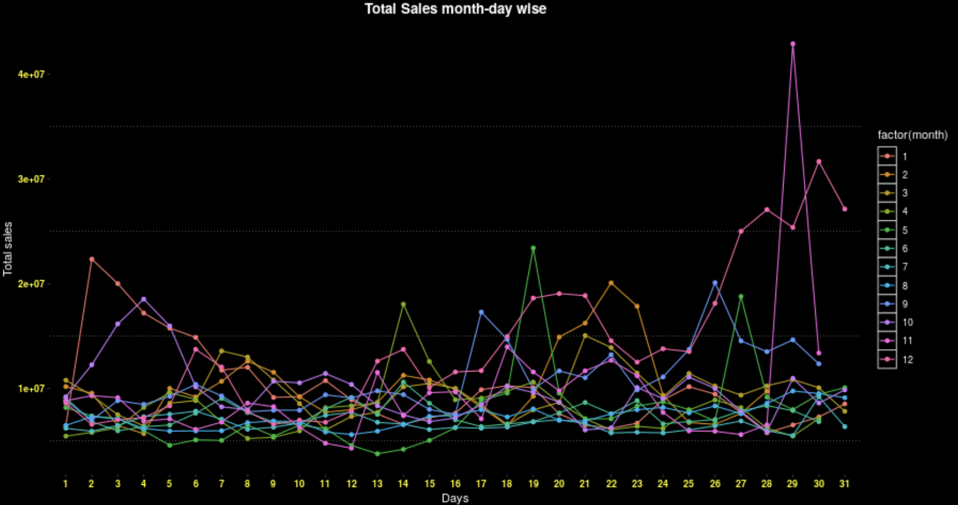
Total sales Month-day and Year wise

Slide 13
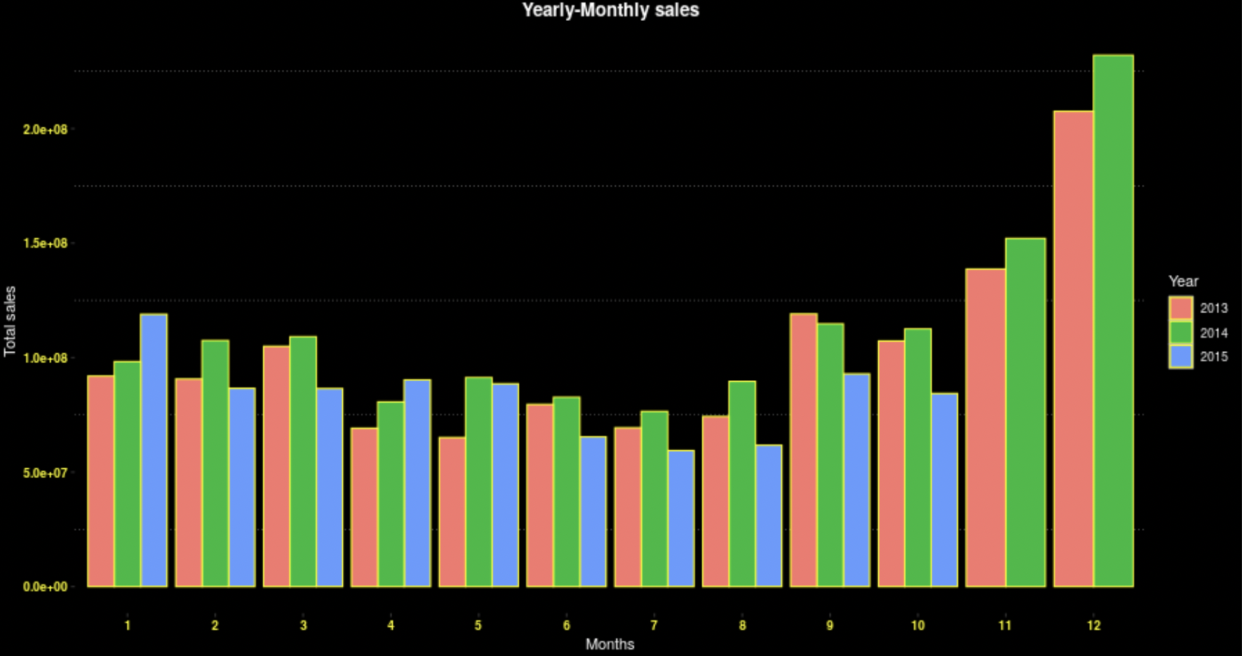
Yearly-Monthly Sales

Slide 14
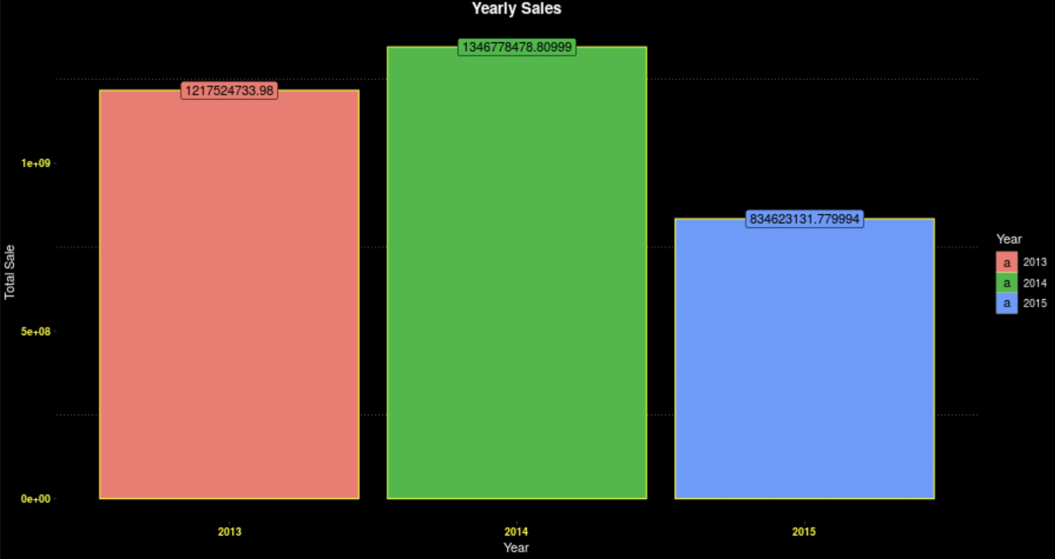
Yearly Sales

Slide 15
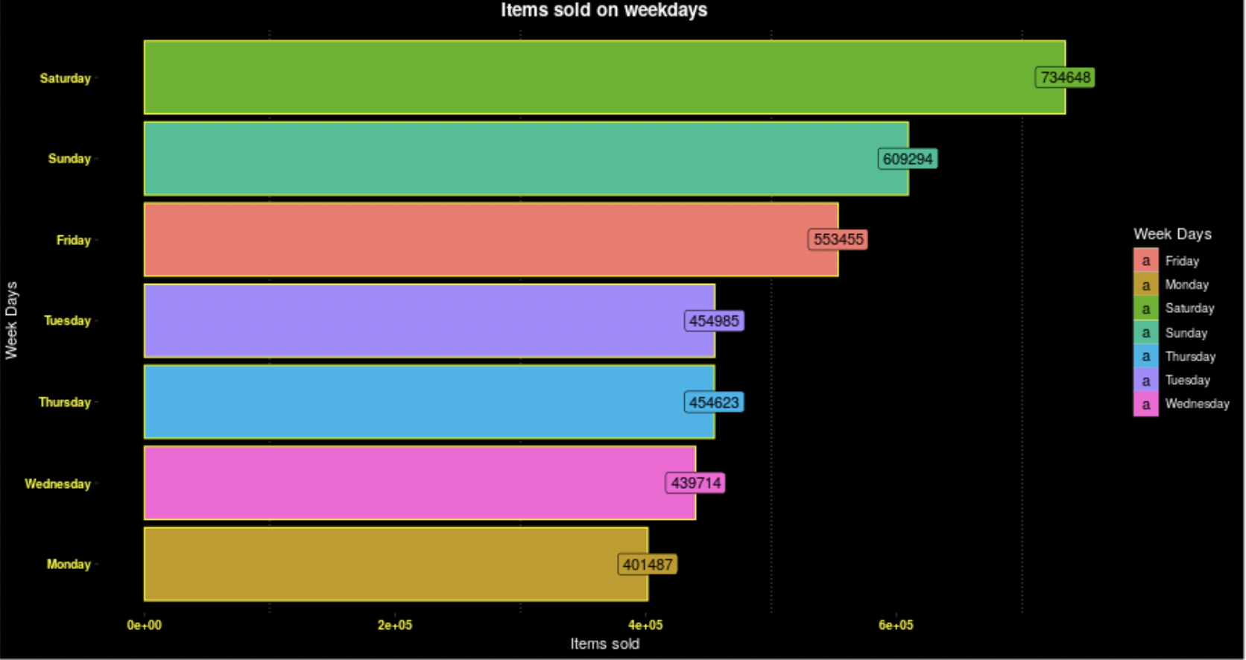
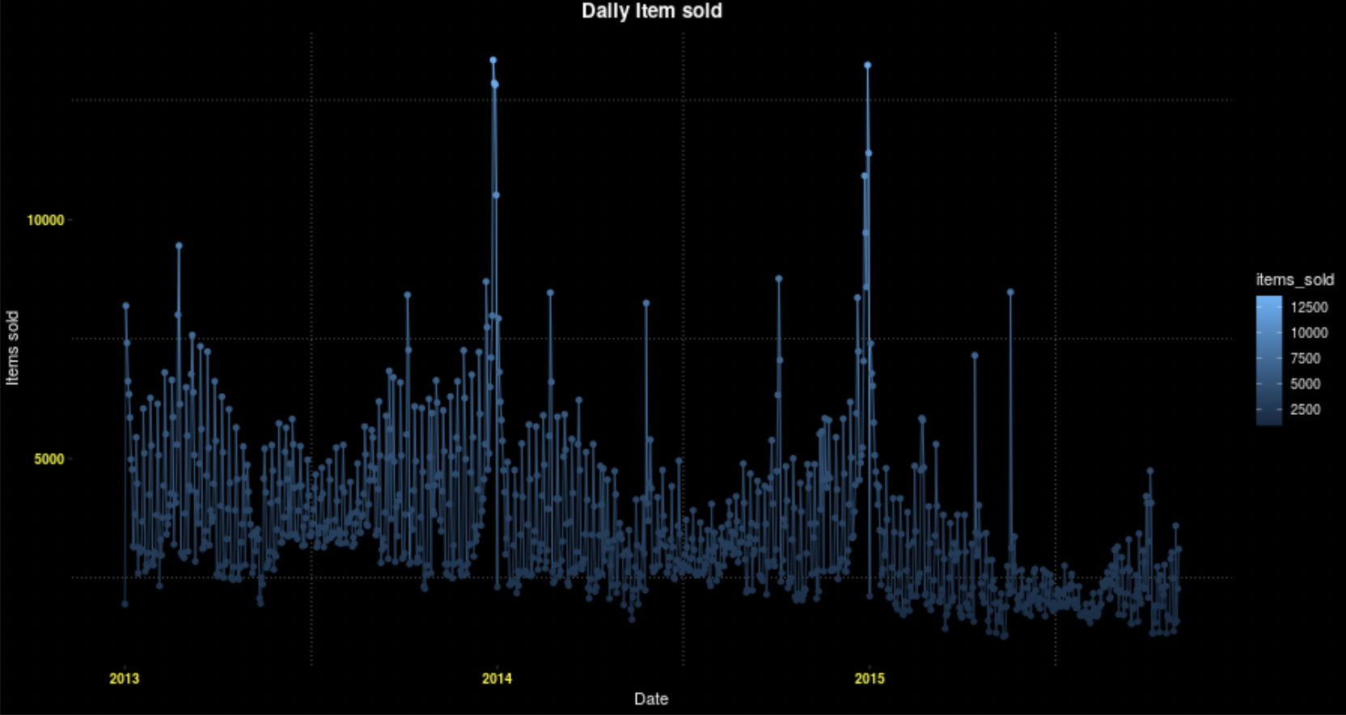
Items sold on weekdays; Daily item sold

Slide 16
Conclusion
We used gradient boosting model(gbm) as we can deal directly with the variables of choice, use cross-fold validation parameter. Also RMSE(root mean squared error) is easy to interpret.
GBM offers partial dependency plot which helps us explore correlations between features.
Why not XGBOOST?-
There was no need to create sparse matrices as the dataset was limited.

